Slide 1
Snoop-based Multiprocessor Design

Slide 2
Design Goals
Performance and cost depend on design and implementation too
Goals
  Correctness
  High Performance
  Minimal Hardware
Often at odds
  High Performance => multiple outstanding low-level events
  => more complex interactions
  => more potential correctness bugs
We’ll start simply and add concurrency to the design

Slide 3
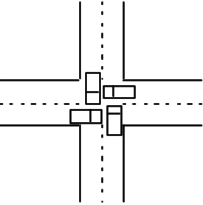
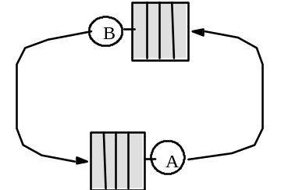
Correctness Issues
Fulfil conditions for coherence and consistency
  Write propagation, serialization; for SC: completion, atomicity
Deadlock: all system activity ceases
  Cycle of resource dependences
Livelock: no processor makes forward progress although transactions are performed at hardware level
  e.g. simultaneous writes in invalidation-based protocol
    each requests ownership, invalidating other, but loses it before winning arbitration for the bus
Starvation: one or more processors make no forward progress while others do.
  e.g. interleaved memory system with NACK on bank busy
  Often not completely eliminated (not likely, not catastrophic)

Slide 4
Base Cache Coherence Design
Single-level write-back cache
Invalidation protocol
One outstanding memory request per processor
Atomic memory bus transactions
  For BusRd, BusRdX no intervening transactions allowed on bus between issuing address and receiving data
  BusWB: address and data simultaneous and sinked by memory system before any new bus request
Atomic operations within process
  One finishes before next in program order starts
Examine write serialization, completion, atomicity
Then add more concurrency/complexity and examine again

Slide 5
Some Design Issues
Design of cache controller and tags
  Both processor and bus need to look up
How and when to present snoop results on bus
Dealing with write backs
Overall set of actions for memory operation not atomic
  Can introduce race conditions
New issues deadlock, livelock, starvation, serialization, etc.
Implementing atomic operations (e.g. read-modify-write)
Let’s examine one by one ...

Slide 6
Cache Controller and Tags
Cache controller stages components of an operation
  Itself a finite state machine (but not same as protocol state machine)
Uniprocessor: On a miss:
  Assert request for bus
  Wait for bus grant
  Drive address and command lines
  Wait for command to be accepted by relevant device
  Transfer data
In snoop-based multiprocessor, cache controller must:
  Monitor bus and processor
    Can view as two controllers: bus-side, and processor-side
    With single-level cache: dual tags (not data) or dual-ported tag RAM
      must reconcile when updated, but usually only looked up
  Respond to bus transactions when necessary (multiprocessor-ready)

Slide 7
Reporting Snoop Results: How?
Collective response from caches must appear on bus
Example: in MESI protocol, need to know
  Is block dirty; i.e. should memory respond or not?
  Is block shared; i.e. transition to E or S state on read miss?
Three wired-OR signals
  Shared: asserted if any cache has a copy
  Dirty: asserted if some cache has a dirty copy
    needn’t know which, since it will do what’s necessary
  Snoop-valid: asserted when OK to check other two signals
    actually inhibit until OK to check
Illinois MESI requires priority scheme for cache-to-cache transfers
  Which cache should supply data when in shared state?
  Commercial implementations allow memory to provide data

Slide 8
Reporting Snoop Results: When?
Memory needs to know what, if anything, to do
Fixed number of clocks from address appearing on bus
  Dual tags required to reduce contention with processor
  Still must be conservative (update both on write: E -> M)
  Pentium Pro, HP servers, Sun Enterprise
Variable delay
  Memory assumes cache will supply data till all say “sorry”
  Less conservative, more flexible, more complex
  Memory can fetch data and hold just in case (SGI Challenge)
Immediately: Bit-per-block in memory
  Extra hardware complexity in commodity main memory system

Slide 9
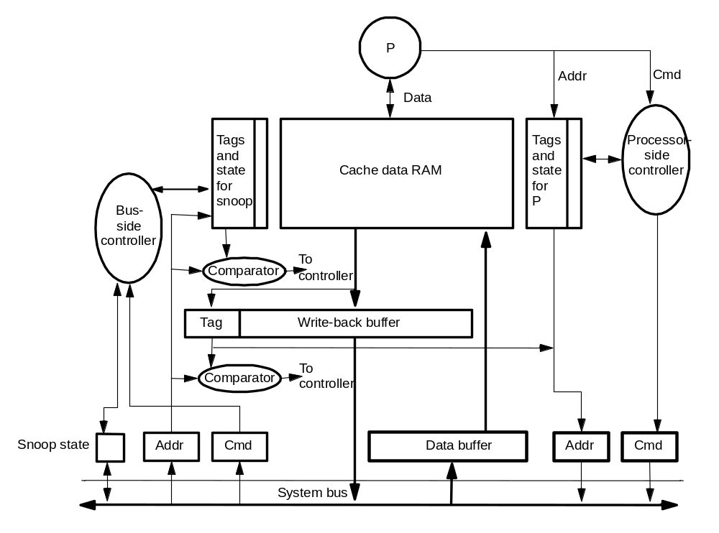
Writebacks
To allow processor to continue quickly, want to service miss first and then process the write back caused by the miss asynchronously
  Need write-back buffer
  Must handle bus transactions relevant to buffered block
    snoop the WB buffer

Slide 10
Non-Atomic State Transitions
Memory operation involves many actions by many entities, incl. bus
  Look up cache tags, bus arbitration, actions by other controllers, ...
  Even if bus is atomic, overall set of actions is not
  Can have race conditions among components of different operations
Suppose P1 and P2 attempt to write cached block A simultaneously
  Each decides to issue BusUpgr to allow S –> M
Issues
  Must handle requests for other blocks while waiting to acquire bus
  Must handle requests for this block A
    e.g. if P2 wins, P1 must invalidate copy and modify request to BusRdX

Slide 11
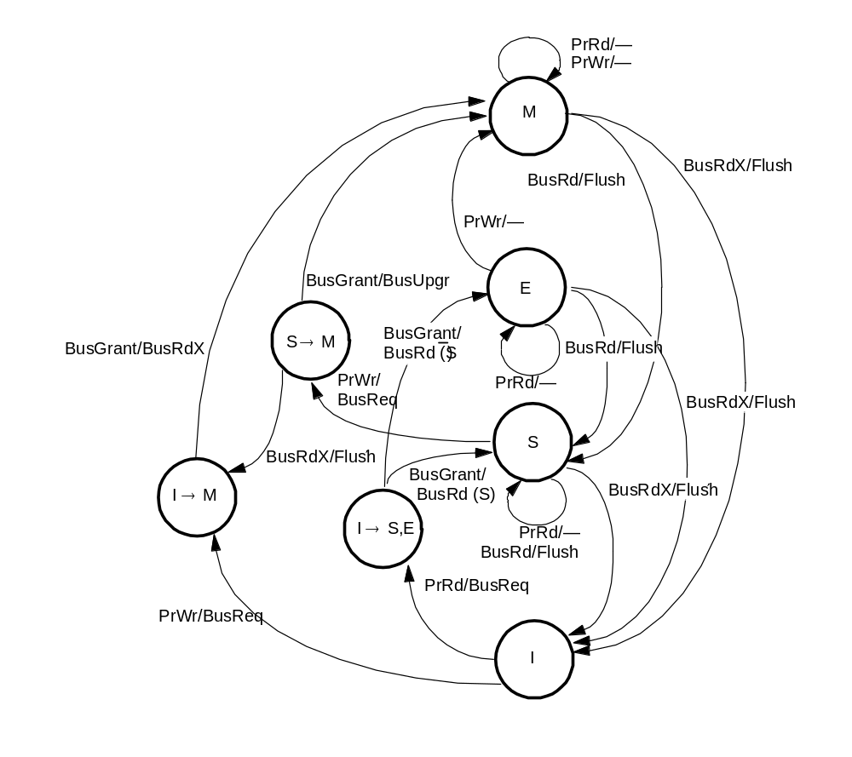
Handling Non-atomicity: Transient States
Two types of states
  Stable (e.g. MESI)
  Transient or Intermediate
Increase complexity, so many seek to avoid
    e.g. don’t use BusUpgr, rather other mechanisms to avoid data transfer

Slide 12
Serialization
Processor-cache handshake must preserve serialization of bus order
  e.g. on write to block in S state, mustn’t write data in block until ownership is acquired.
    other transactions that get bus before this one may seem to appear later
Write completion for SC: needn’t wait for inval to actuallly happen
  Just wait till it gets bus (here, will happen before next bus xaction)
  Commit versus complete
  Don’t know when inval actually inserted in destination process’s local order, only that it’s before next xaction and in same order for all procs
  Local write hits become visible not before next bus transaction
  Same argument will extend to more complex systems
  What matters is not when written data gets on the bus (write back), but when subsequent reads are guaranteed to see it
Write atomicity: if a read returns value of a write W, W has already gone to bus and therefore completed if it needed to

Slide 13
Deadlock, Livelock, Starvation
Request-reply protocols can lead to protocol-level, fetch deadlock
  In addition to buffer deadlock discussed earlier
  When attempting to issue requests, must service incoming transactions
    e.g. cache controller awaiting bus grant must snoop and even flush blocks
    else may not respond to request that will release bus: deadlock
Livelock: many processors try to write same line. Each one:
  Obtains exclusive ownership via bus transaction (assume not in cache)
  Realizes block is in cache and tries to write it
  Livelock: I obtain ownership, but you steal it before I can write, etc.
  Solution: don’t let exclusive ownership be taken away before write
Starvation: solve by using fair arbitration on bus and FIFO buffers
  May require too much buffering; if retries used, priorities as heuristics

Slide 14
Implementing Atomic Operations
Read-modify-write: read component and write component
  Cacheable variable, or perform read-modify-write at memory
    cacheable has lower latency and bandwidth needs for self-reacquisition
    also allows spinning in cache without generating traffic while waiting
    at-memory has lower transfer time
    usually traffic and latency considerations dominate, so use cacheable
  Natural to implement with two bus transactions: read and write
    can lock down bus: okay for atomic bus, but not for split-transaction
    get exclusive ownership, read-modify-write, only then allow others access
    compare&swap more difficult in RISC machines: two registers+memory

Slide 15
Implementing LL-SC
Lock flag and lock address register at each processor
LL reads block, sets lock flag, puts block address in register
Incoming invalidations checked against address: if match, reset flag
  Also if block is replaced and at context switches
SC checks lock flag as indicator of intervening conflicting write
  If reset, fail; if not, succeed
Livelock considerations
  Don’t allow replacement of lock variable between LL and SC
    split or set-assoc. cache, and don’t allow memory accesses between LL, SC
    (also don’t allow reordering of accesses across LL or SC)
  Don’t allow failing SC to generate invalidations (not an ordinary write)
Performance: both LL and SC can miss in cache
  Prefetch block in exclusive state at LL
  But exclusive request reintroduces livelock possibility: use backoff

Slide 16
Multi-level Cache Hierarchies
How to snoop with multi-level caches?
  independent bus snooping at every level?
  maintain cache inclusion
Requirements for Inclusion
  data in higher-level cache is subset of data in lower-level cache
  modified in higher-level => marked modified in lower-level
Now only need to snoop lowest-level cache
  If L2 says not present (modified), then not so in L1 too
  If BusRd seen to block that is modified in L1, L2 itself knows this
Is inclusion automatically preserved
  Replacements: all higher-level misses go to lower level
  Modifications

Slide 17
Violations of Inclusion
The two caches (L1, L2) may choose to replace different block
  Differences in reference history
    set-associative first-level cache with LRU replacement
    example: blocks m1, m2, m3 fall in same set of L1 cache...
  Split higher-level caches
    instruction, data blocks go in different caches at L1, but may collide in L2
    what if L2 is set-associative?
  Differences in block size
But a common case works automatically
  L1 direct-mapped, fewer sets than in L2, and block size same

Slide 18
Preserving Inclusion Explicitly
Propagate lower-level (L2) replacements to higher-level (L1)
  Invalidate or flush (if dirty) messages
Propagate bus transactions from L2 to L1
  Propagate all transactions, or use inclusion bits
Propagate modified state from L1 to L2 on writes?
  Write-through L1, or modified-but-stale bit per block in L2 cache
Correctness issues altered?
  Not really, if all propagation occurs correctly and is waited for
  Writes commit when they reach the bus, acknowledged immediately
  But performance problems, so want to not wait for propagation
  Discuss after split-transaction busses
Dual cache tags less important: each cache is filter for other

Slide 19
Split-Transaction Bus
Split bus transaction into request and response sub-transactions
  Separate arbitration for each phase
Other transactions may intervene
  Improves bandwidth dramatically
  Response is matched to request
  Buffering between bus and cache controllers
Reduce serialization down to the actual bus arbitration
Mem Access Delay
Mem Access Delay
Data
Data
Address/CMD
Address/CMD
Address/CMD
Bus
arbitration

Slide 20
Complications
New request can appear on bus before previous one serviced
  Even before snoop result obtained
  Conflicting operations to same block may be outstanding on bus
  e.g. P1, P2 write block in S state at same time
    both get bus before either gets snoop result, so both think they’ve won
  Note: different from overall non-atomicity discussed earlier
Buffers are small, so may need flow control
Buffering implies revisiting snoop issues
  When and how snoop results and data responses are provided
  In order w.r.t. requests? (PPro, DEC Turbolaser: yes; SGI, Sun: no)
  Snoop and data response together or separately?
    SGI together, SUN separately
Large space, much industry innovation: let’s look at one example first

Slide 21
Example (based on SGI Challenge)
No conflicting requests for same block allowed on bus
  8 outstanding requests total, makes conflict detection tractable
Flow-control through negative acknowledgement (NACK)
  NACK as soon as request appears on bus, requestor retries
  Separate command (incl. NACK) + address and tag + data buses
Responses may be in different order than requests
  Order of transactions determined by requests
  Snoop results presented on bus with response
Look at
  Bus design, and how requests and responses are matched
  Snoop results and handling conflicting requests
  Flow control
  Path of a request through the system

Slide 22
Bus Design and Req-Resp Matching
Essentially two separate buses, arbitrated independently
  “Request” bus for command and address
  “Response” bus for data
Out-of-order responses imply need for matching req-response
  Request gets 3-bit tag when wins arbitration (8 outstanding max)
  Response includes data as well as corresponding request tag
  Tags allow response to not use address bus, leaving it free
Separate bus lines for arbitration, and for snoop results

Slide 23
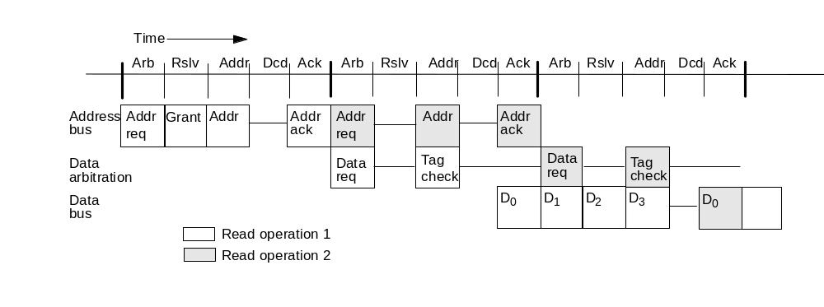
Bus Design (continued)
Each of request and response phase is 5 bus cycles (best case)
  Response: 4 cycles for data (128 bytes, 256-bit bus), 1 turnaround
  Request phase: arbitration, resolution, address, decode, ack
  Request-response transaction takes 3 or more of these
Cache tags looked up in decode; extend ack cycle if not possible
  Determine who will respond, if any
  Actual response comes later, with re-arbitration
Write-backs have request phase only: arbitrate both data+addr buses
Upgrades have only request part; ack’ed by bus on grant (commit)

Slide 24
Bus Design (continued)
Tracking outstanding requests and matching responses
  Eight-entry “request table” in each cache controller
  New request on bus added to all at same index, determined by tag
  Entry holds address, request type, state in that cache (if determined already), ...
  All entries checked on bus or processor accesses for match, so fully associative
  Entry freed when response appears, so tag can be reassigned by bus

Slide 25
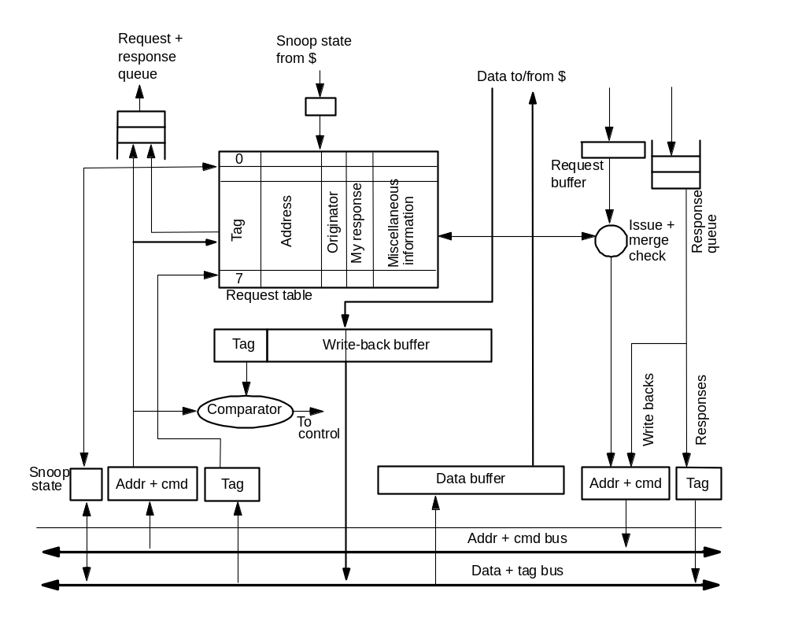
Bus Interface with Request Table

Slide 26
Snoop Results and Conflicting Requests
Variable-delay snooping
Shared, dirty and inhibit wired-OR lines, as before
Snoop results presented when response appears
  Determined earlier, in request phase, and kept in request table entry
  (Also determined who will respond)
  Writebacks and upgrades don’t have data response or snoop result
Avoiding conflicting requests on bus
  easy: don’t issue request for conflicting request that is in request table
Recall writes committed when request gets bus

Slide 27
Flow Control
Not just at incoming buffers from bus to cache controller
Cache system’s buffer for responses to its requests
  Controller limits number of outstanding requests, so easy
Mainly needed at main memory in this design
  Each of the 8 transactions can generate a writeback
  Can happen in quick succession (no response needed)
  SGI Challenge: separate NACK lines for address and data buses
    Asserted before ack phase of request (response) cycle is done
    Request (response) cancelled everywhere, and retries later
    Backoff and priorities to reduce traffic and starvation
  SUN Enterprise: destination initiates retry when it has a free buffer
    source keeps watch for this retry
    guaranteed space will still be there, so only two “tries” needed at most

Slide 28
Handling a Read Miss
Need to issue BusRd
First check request table. If hit:
  If prior request exists for same block, want to grab data too!
    “want to grab response” bit
    “original requestor” bit
      non-original grabber must assert sharing line so others will load in S rather than E state
  If prior request incompatible with BusRd (e.g. BusRdX)
    wait for it to complete and retry (processor-side controller)
  If no prior request, issue request and watch out for race conditions
    conflicting request may win arbitration before this one, but this one receives bus grant before conflict is apparent
      watch for conflicting request in slot before own, degrade request to “no action” and withdraw till conflicting request satisfied

Slide 29
Upon Issuing the BusRd Request
All processors enter request into table, snoop for request in cache
Memory starts fetching block
1. Cache with dirty block responds before memory ready
  Memory aborts on seeing response
  Waiters grab data
    some may assert inhibit to extend response phase till done snooping
    memory must accept response as WB (might even have to NACK)
2. Memory responds before cache with dirty block
  Cache with dirty block asserts inhibit line till done with snoop
  When done, asserts dirty, causing memory to cancel response
  Cache with dirty issues response, arbitrating for bus
3. No dirty block: memory responds when inhibit line released
  Assume cache-to-cache sharing not used (for non-modified data)

Slide 30
Handling a Write Miss
Similar to read miss, except:
  Generate BusRdX
  Main memory does not sink response since will be modified again
  No other processor can grab the data
If block present in shared state, issue BusUpgr instead
  No response needed
  If another processor was going to issue BusUpgr, changes to BusRdX as with atomic bus

Slide 31
Write Serialization
With split-transaction buses, usually bus order is determined by order of requests appearing on bus
  actually, the ack phase, since requests may be NACKed
  by end of this phase, they are committed for visibility in order
A write that follows a read transaction to the same location should not be able to affect the value returned by that read
  Easy in this case, since conflicting requests not allowed
  Read response precedes write request on bus
Similarly, a read that follows a write transaction won’t return old value

Slide 32
Detecting Write Completion
Problem: invalidations don’t happen as soon as request appears on bus
  They’re buffered between bus and cache
  Commitment does not imply performing or completion
  Need additional mechanisms
Key property to preserve: processor shouldn’t see new value produced by a write before previous writes in bus order are visible to it
  1. Don’t let certain types of incoming transactions be reordered in buffers
    in particular, data reply should not overtake invalidation request
    okay for invalidations to be reordered: only reply actually brings data in
  2. Allow reordering in buffers, but ensure important orders preserved at key points
    e.g. flush incoming invalidations/updates from queues and apply before processor completes operation that may enable it to see a new value

Slide 33
Commitment of Writes (Operations)
More generally, distinguish between performing and commitment of a write w:
Performed w.r.t a processor: invalidation actually applied
Committed w.r.t a processor: guaranteed that once that processor sees the new value associated with W, any subsequent read by it will see new values of all writes that were committed w.r.t that processor before W.
Global bus serves as point of commitment, if buffers are FIFO
  benefit of a serializing broadcast medium for interconnect
Note: acks from bus to processor must logically come via same FIFO
  not via some special signal, since otherwise can violate ordering

Slide 34
Write Atomicity
Still provided naturally by broadcast nature of bus
Recall that bus implies:
  writes commit in same order w.r.t. all processors
  read cannot see value produced by write before write has committed on bus and hence w.r.t. all processors
Previous techniques allow substitution of “complete” for “commit” in above statements
  that’s write atomicity
Will discuss deadlock, livelock, starvation after multilevel caches plus split transaction bus

Slide 35
Alternatives: In-order Responses
FIFO request table suffices
Dirty cache does not release inhibit line till it is ready to supply data
  No deadlock problem since does not rely on anyone else
But performance problems possible at interleaved memory
  Major motivation for allowing out-of-order responses
Allow conflicting requests more easily
  Two BusRdX requests one after the other on bus for same block
    latter controller invalidates its block, as before
    but earlier requestor sees later request before its own data response
    with out-of-order response, not known which response will appear first
    with in-order, known, and actually can use performance optimization
    earlier controller responds to latter request by noting that latter is pending
    when its response arrives, updates word, short-cuts block back on to bus, invalidates its copy (reduces ping-pong latency)

Slide 36
Other Alternatives
Fixed delay from request to snoop result also makes it easier
  Can have conflicting requests even if data responses not in order
  e.g. SUN Enterprise
    64-byte line and 256-bit bus => 2 cycle data transfer
    so 2-cycle request phase used too, for uniform pipelines
    too little time to snoop and extend request phase
    snoop results presented 5 cycles after address (unless inhibited)
    by later data response arrival, conflicting requestors know what to do
Don’t even need request to go on same bus, as long as order is well-defined
  SUN SparcCenter2000 had 2 busses, Cray 6400 had 4
  Multiple requests go on bus in same cycle
  Priority order established among them is logical order

Slide 37
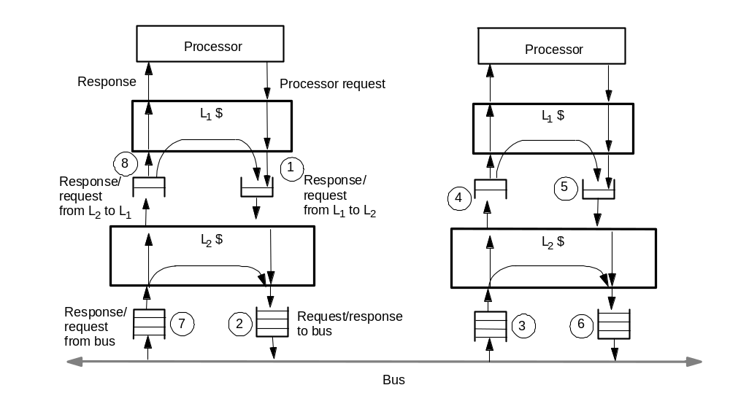
Multi-Level Caches with ST Bus
Key new problem: many cycles to propagate through hierarchy
  Must let others propagate too for bandwidth, so queues between levels
Introduces deadlock and serialization problems

Slide 38
Deadlock Considerations
Fetch deadlock:
  Must buffer incoming requests/responses while request outstanding
  One outstanding request per processor => need space to hold p requests plus one reply (latter is essential)
  If smaller (or if multiple o/s requests), may need to NACK
  Then need priority mechanism in bus arbiter to ensure progress
Buffer deadlock:
  L1 to L2 queue filled with read requests, waiting for response from L2
  L2 to L1 queue filled with bus requests waiting for response from L1
  Latter condition only when cache closer than lowest level is write back
  Could provide enough buffering, or general solutions discussed later
If # o/s bus transactions smaller than total o/s cache misses, response from cache must get bus before new requests from it allowed
  Queues may need to support bypassing

Slide 39
Sequential Consistency
Separation of commitment from completion even greater now
  More performance-critical that commitment replace completion
Fortunately techniques for single-level cache and ST bus extend
  Just use them at each level
  i.e. either don’t allow certain reorderings of transactions at any level
  Or don’t let outgoing operation proceed past level before incoming invalidations/updates at that level are applied

Slide 40
Multiple Outstanding Processor Requests
So far assumed only one: not true of modern processors
Danger: operations from same processor can complete out of order
  e.g. write buffer: until serialized by bus, should not be visible to others
  Uniprocessors use write buffer to insert multiple writes in succession
    multiprocessors usually can’t do this while ensuring consistent serialization
    exception: writes are to same block, and no intervening ops in program order
Key question: who should wait to issue next op till previous completes
  Key to high performance: processor needn’t do it (so can overlap)
  Queues/buffers/controllers can ensure writes not visible to external world and reads don’t complete (even if back) until allowed (more later)
Other requirement: caches must be lockup free to be effective
  Merge operations to a block, so rest of system sees only one o/s to block
All needed mechanisms for correctness available (deeper queues for performance)

Slide 41
Case Studies of Bus-based Machines
SGI Challenge, with Powerpath bus
SUN Enterprise, with Gigaplane bus
  Take very different positions on the design issues discussed above
Overview
For each system:
  Bus design
  Processor and Memory System
  Input/Output system
  Microbenchmark memory access results
Application performance and scaling (SGI Challenge)

Slide 42
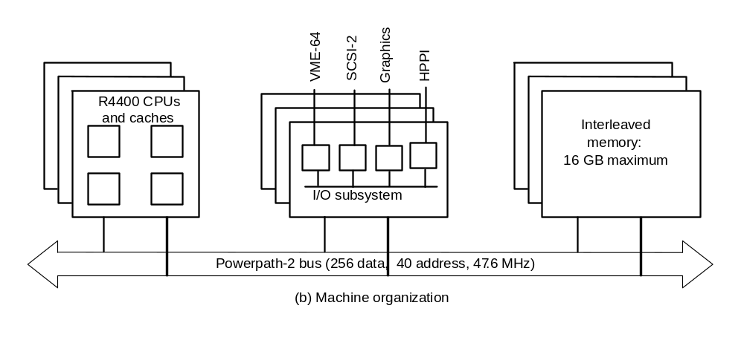
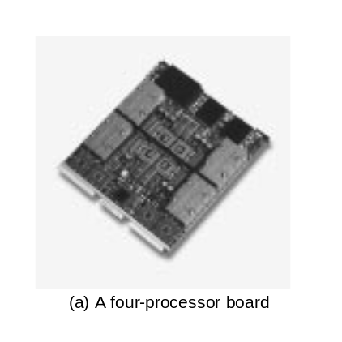
SGI Challenge Overview
36 MIPS R4400 (peak 2.7 GFLOPS, 4 per board) or 18 MIPS R8000 (peak 5.4 GFLOPS, 2 per board)
8-way interleaved memory (up to 16 GB)
4 I/O busses of 320 MB/s each
1.2 GB/s Powerpath-2 bus @ 47.6 MHz, 16 slots, 329 signals
128 Bytes lines (1 + 4 cycles)
Split-transaction with up to 8 outstanding reads
  all transactions take five cycles

Slide 43
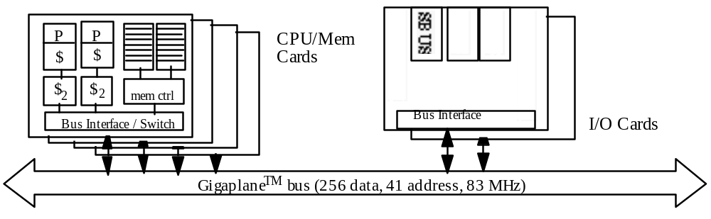
SUN Enterprise Overview
Up to 30 UltraSPARC processors (peak 9 GFLOPs)
GigaplaneTM bus has peak bw 2.67 GB/s; upto 30GB memory
16 bus slots, for processing or I/O boards
  2 CPUs and 1GB memory per board
    memory distributed, unlike Challenge, but protocol treats as centralized
  Each I/O board has 2 64-bit 25Mhz SBUSes

Slide 44
Bus Design Issues
Multiplexed versus non-multiplexed (separate addr and data lines)
Wide versus narrow data busses
Bus clock rate
  Affected by signaling technology, length, number of slots...
Split transaction versus atomic
Flow control strategy

Slide 45
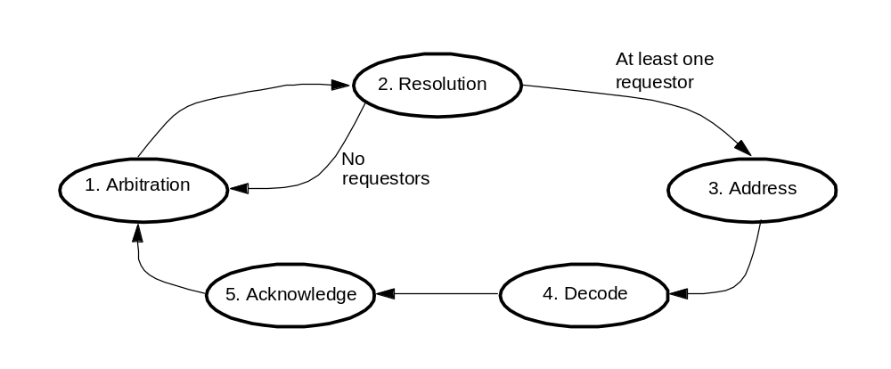
SGI Powerpath-2 Bus
Non-multiplexed, 256-data/40-address, 47.6 MHz, 8 o/s requests
Wide => more interface chips so higher latency, but more bw at slower clock
Large block size also calls for wider bus
Uses Illinois MESI protocol (cache-to-cache sharing)
More detail in chapter

Slide 46
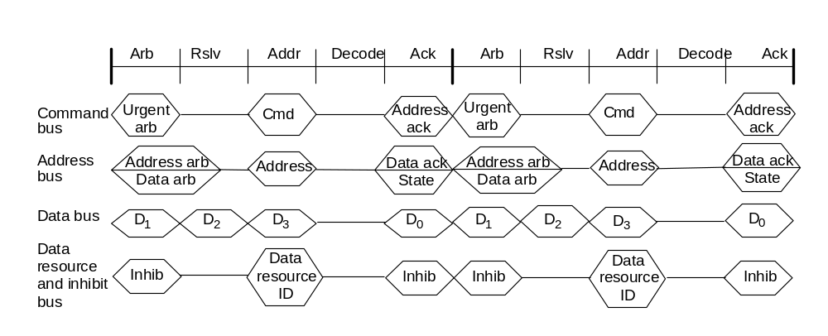
Bus Timing

Slide 47
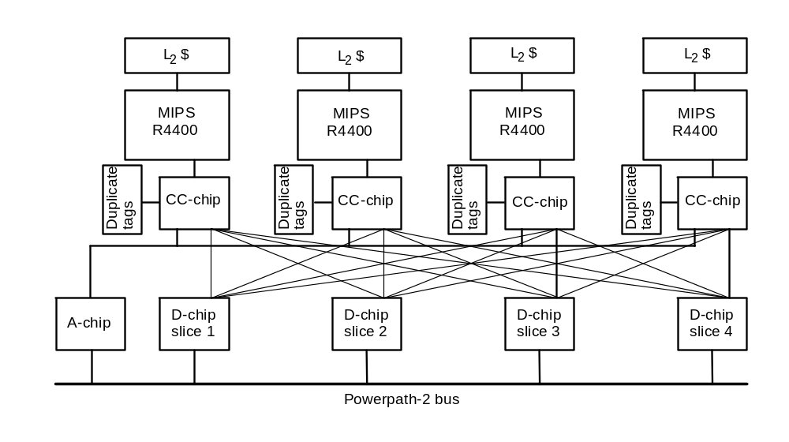
Processor and Memory Systems
4 MIPS R4400 processors per board share A and D chips
A chip has address bus interface, request table, control logic
CC chip per processor has duplicate set of tags
Processor requests go from CC chip to A chip to bus
4 bit-sliced D chips interface CC chip to bus

Slide 48
Memory Access Latency
250ns access time from address on bus to data on bus
But overall latency seen by processor is 1000ns!
  300 ns for request to get from processor to bus
    down through cache hierarchy, CC chip and A chip
  400ns later, data gets to D chips
    3 bus cycles to address phase of request transaction, 12 to access main memory, 5 to deliver data across bus to D chips
  300ns more for data to get to processor chip
    up through D chips, CC chip, and 64-bit wide interface to processor chip, load data into primary cache, restart pipeline

Slide 49
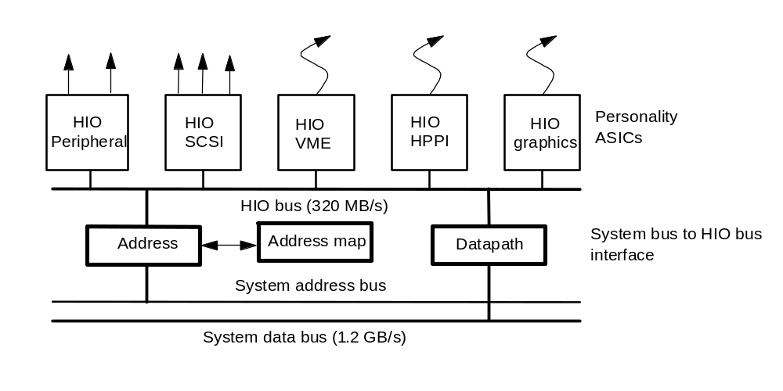
Challenge I/O Subsystem
Multiple I/O cards on system bus, each has 320MB/s HIO bus
  Personality ASICs connect these to devices (standard and graphics)
Proprietary HIO bus
  64-bit multiplexed address/data, same clock as system bus
  Split read transactions, up to 4 per device
  Pipelined, but centralized arbitration, with several transaction lengths
  Address translation via mapping RAM in system bus interface
Why the decouplings? (Why not connect directly to system bus?)
I/O board acts like a processor to memory system

Slide 50
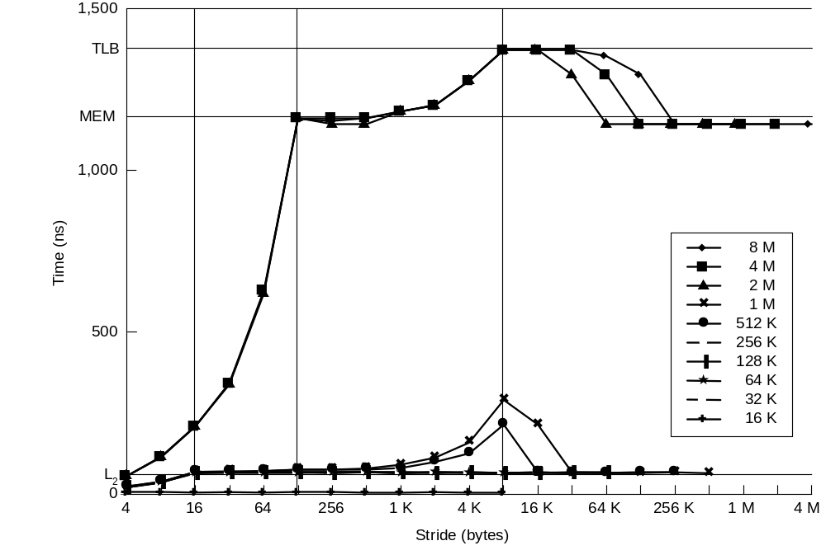
Challenge Memory System Performance
Read microbenchmark with various strides and array sizes
Ping-pong flag-spinning microbenchmark: round-trip time 6.2 μs.

Slide 51
Sun Gigaplane Bus
Non-multiplexed, split-transaction, 256-data/41-address, 83.5 MHz
  Plus 32 ECC lines, 7 tag, 18 arbitration, etc. Total 388.
Cards plug in on both sides: 8 per side
112 outstanding transactions, up to 7 from each board
  Designed for multiple outstanding transactions per processor
Emphasis on reducing latency, unlike Challenge
  Speculative arbitration if address bus not scheduled from prev. cycle
  Else regular 1-cycle arbitration, and 7-bit tag assigned in next cycle
Snoop result associated with request phase (5 cycles later)
Main memory can stake claim to data bus 3 cycles into this, and start memory access speculatively
  Two cycles later, asserts tag bus to inform others of coming transfer
MOESI protocol (owned state for cache-to-cache sharing)

Slide 52
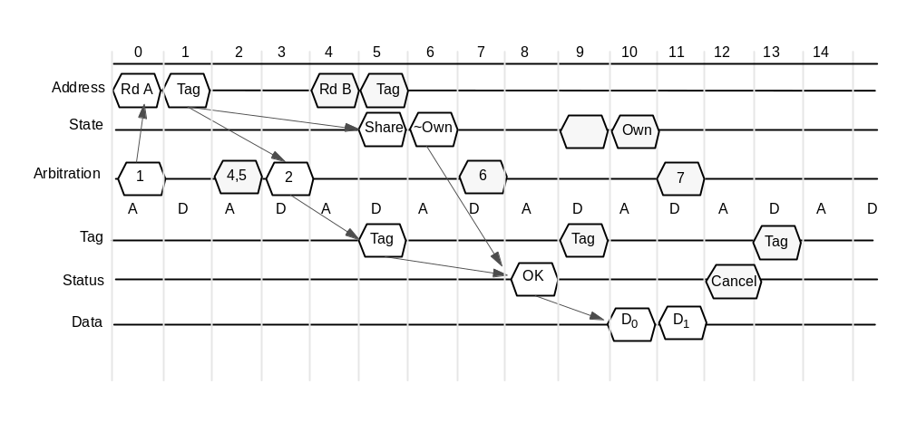
Gigaplane Bus Timing

Slide 53
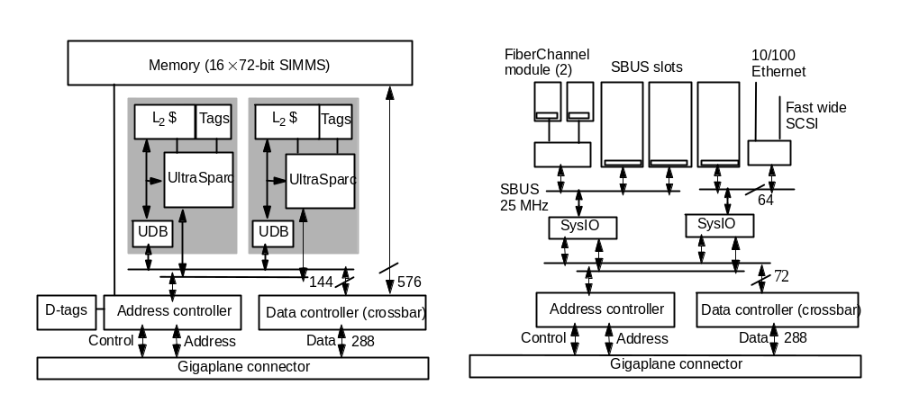
Enterprise Processor and Memory System
2 procs per board, external L2 caches, 2 mem banks with x-bar
Data lines buffered through UDB to drive internal 1.3 GB/s UPA bus
Wide path to memory so full 64-byte line in 1 mem cycle (2 bus cyc)
Addr controller adapts proc and bus protocols, does cache coherence
  its tags keep a subset of states needed by bus (e.g. no M/E distinction)

Slide 54
Enterprise I/O System
I/O board has same bus interface ASICs as processor boards
But internal bus half as wide, and no memory path
Only cache block sized transactions, like processing boards
  Uniformity simplifies design
  ASICs implement single-block cache, follows coherence protocol
Two independent 64-bit, 25 MHz Sbuses
  One for two dedicated FiberChannel modules connected to disk
  One for Ethernet and fast wide SCSI
  Can also support three SBUS interface cards for arbitrary peripherals
Performance and cost of I/O scale with no. of I/O boards

Slide 55
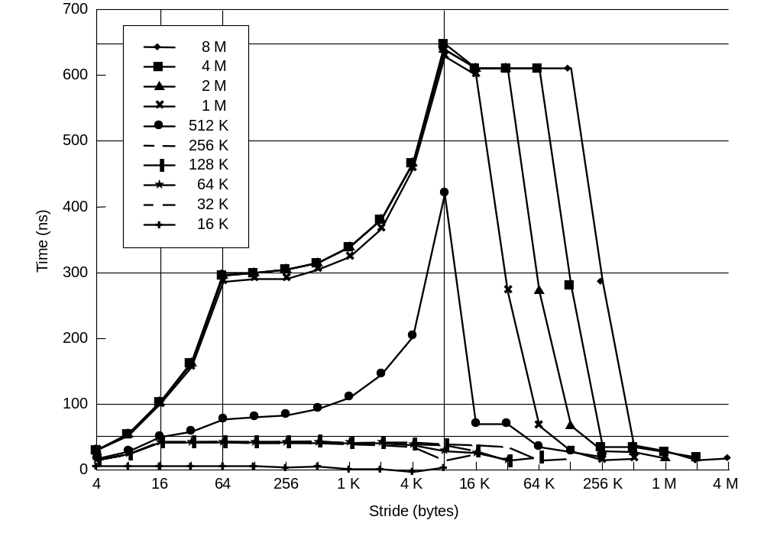
Memory Access Latency
300ns read miss latency
11 cycle min bus protocol at 83.5 Mhz is 130ns of this time
Rest is path through caches and the DRAM access
TLB misses add 340 ns
Ping-pong microbenchmark is 1.7 μs round-trip (5 mem accesses)

Slide 56
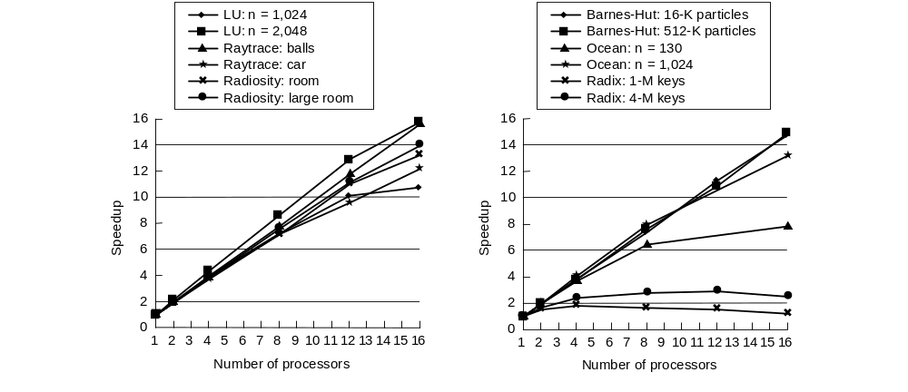
Application Speedups (Challenge)
  Problem in Ocean with small problem: communication and barrier cost
  Problem in Radix: contention on bus due to very high traffic
    also leads to high imbalances and barrier wait time

Slide 57
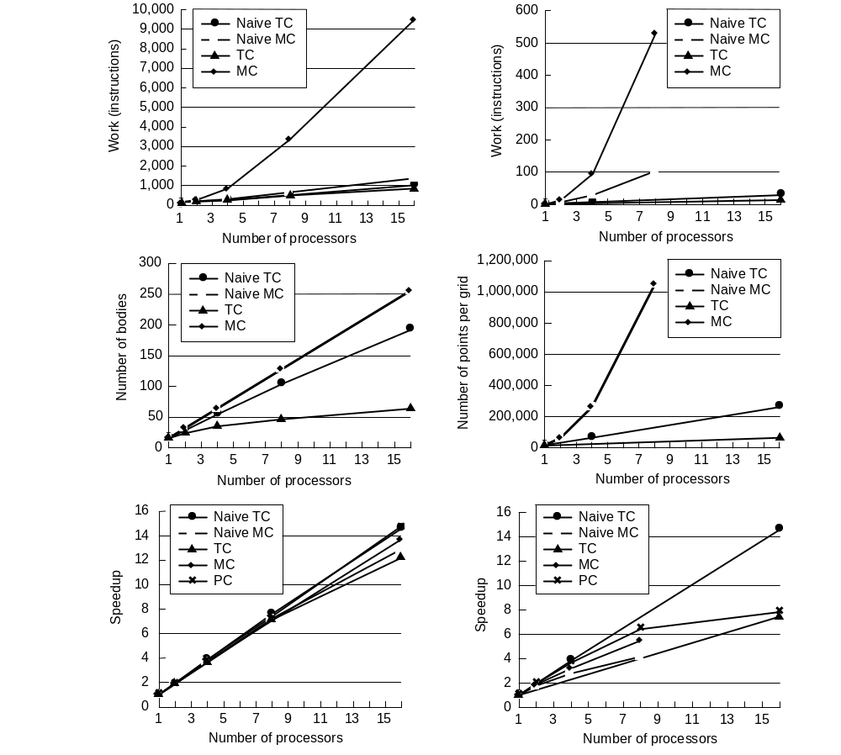
Application Scaling under Other Models

